Slide 1

Entertainer Data Analysis
Powerbi | Python

Slide 2
Project Details
Title | Entertainer Data Analysis
Technologies | Business Intelligence
Domain | Film and Entertainment
Project Difficulties level | Intermediate
Programming language used | Python, SQL
Others tools | PowerBi, Excel, Jupyter Notebook, MS power point

Slide 3
Problem statement
Normal life can be stressful, and people need to relax. Being entertained by others is a wonderful way to take some time out of life. It can reduce stress and make life’s issues easier to face. The media and entertainment industry consists of film, television, radio and print. These segments include movies, TV shows, radio shows, news, music, newspapers, magazines, and books. Entertainment industry is a group of sub-industries devoted to entertainment. Entertainment industry is used to describe the mass media companies that control the distribution and manufacture of mass media entertainment.

Slide 4
Objective
The Goal of this project is to develop a PowerBi Dashboard, which can be used to analysis entertainer’s filmography and their career as well as movie analysis over the year.
Benefits
Entertainer’s filmography can be analysed with a click
Awards of the entertainers can be consumed by the end user
Different KPIs will indicate the main information about the entertainer
Movie count trend or rating of the movies trend over the year can be consumed based on the filters applied

Slide 5

Data preparation Flow
As the provided data is not sufficient for data analysis, I have populated data for the given entertainers and
stored them in local MySQL database using IMDBpy and pandas library.

Slide 6
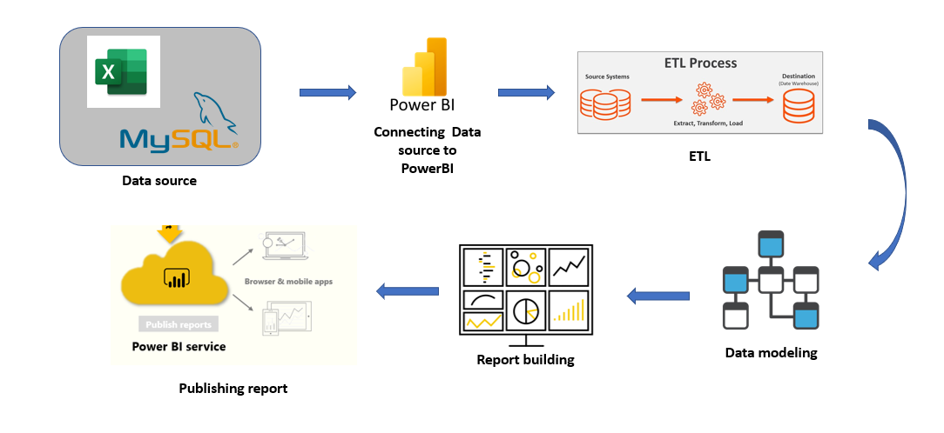
PowerBI Architecture
Overall architecture of the project, which was used to build the dashboard

Slide 7
Dataset Information
Provided Dataset:
Entertainer-Basic Info: It consists of list of 70 Entertainers Name, Birth year and Gender
Entertainer-Breakthrough Info: It consists of details about the 70 entertainers like breakthrough year, first major award, breakthrough movie name
Entertainer-Last major work Info: It consists of the details about the 70 entertainers last major work and if died, Year of death details.

Slide 8
Populated Dataset:
Entertainers_basics_populated:
Name: Entertainer’s name
DOB: Date of birth of the Entertainer
Height: Height of the entertainer
Nicknames: Nicknames of the entertainers, that is used by fans or cinema industry
Quotes: Entertainers quote or statements they made in public
Mini-biography: Mini biography of the entertainer
Trademark: Trademark style or behaviour of the entertainer
Headshot: URL of the entertainers headshot
Entertainers_film_list:
Entertainer name: Name of the entertainer
Movie name: Movie name which the entertainer acted
Year: Release year of the movie

Slide 9
Entertainers_awards:
Name: Entertainer’s name
Award: Award name
Year: Year of the award
Prize: Type of award
Category: Under which category the award has been given
Result: Whether entertainer won the award or just a Nominee (Winner/Nominee)
Movie_name: For which movie the award was given
Shared_with: with they shared the award with someone, there name
Entertainer_salary:
Name: Entertainer’s name
Movie_name: Movie name of the salary they received
Year: Movie released year
Salary: Amount they received for that movie

Slide 10

Home Page

Slide 11
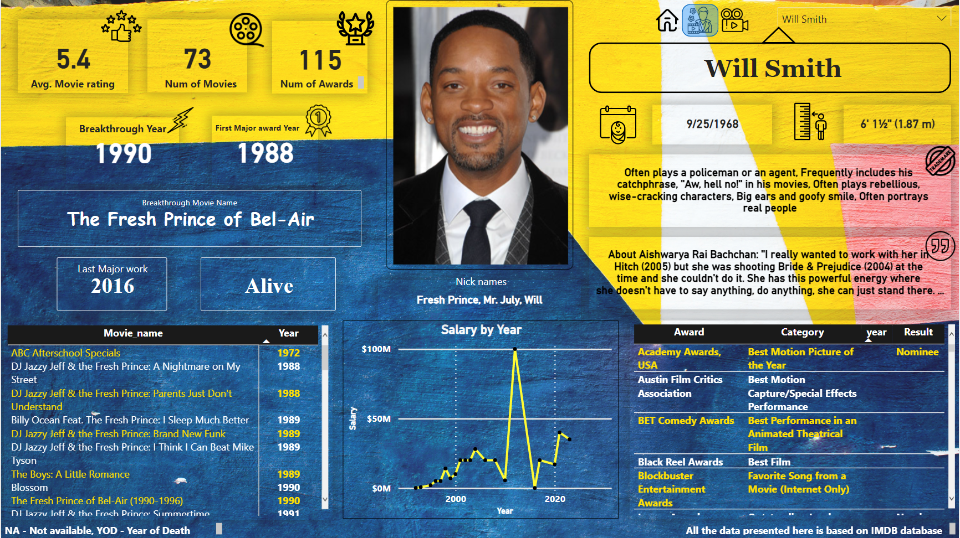
Entertainer Analysis Page

Slide 12
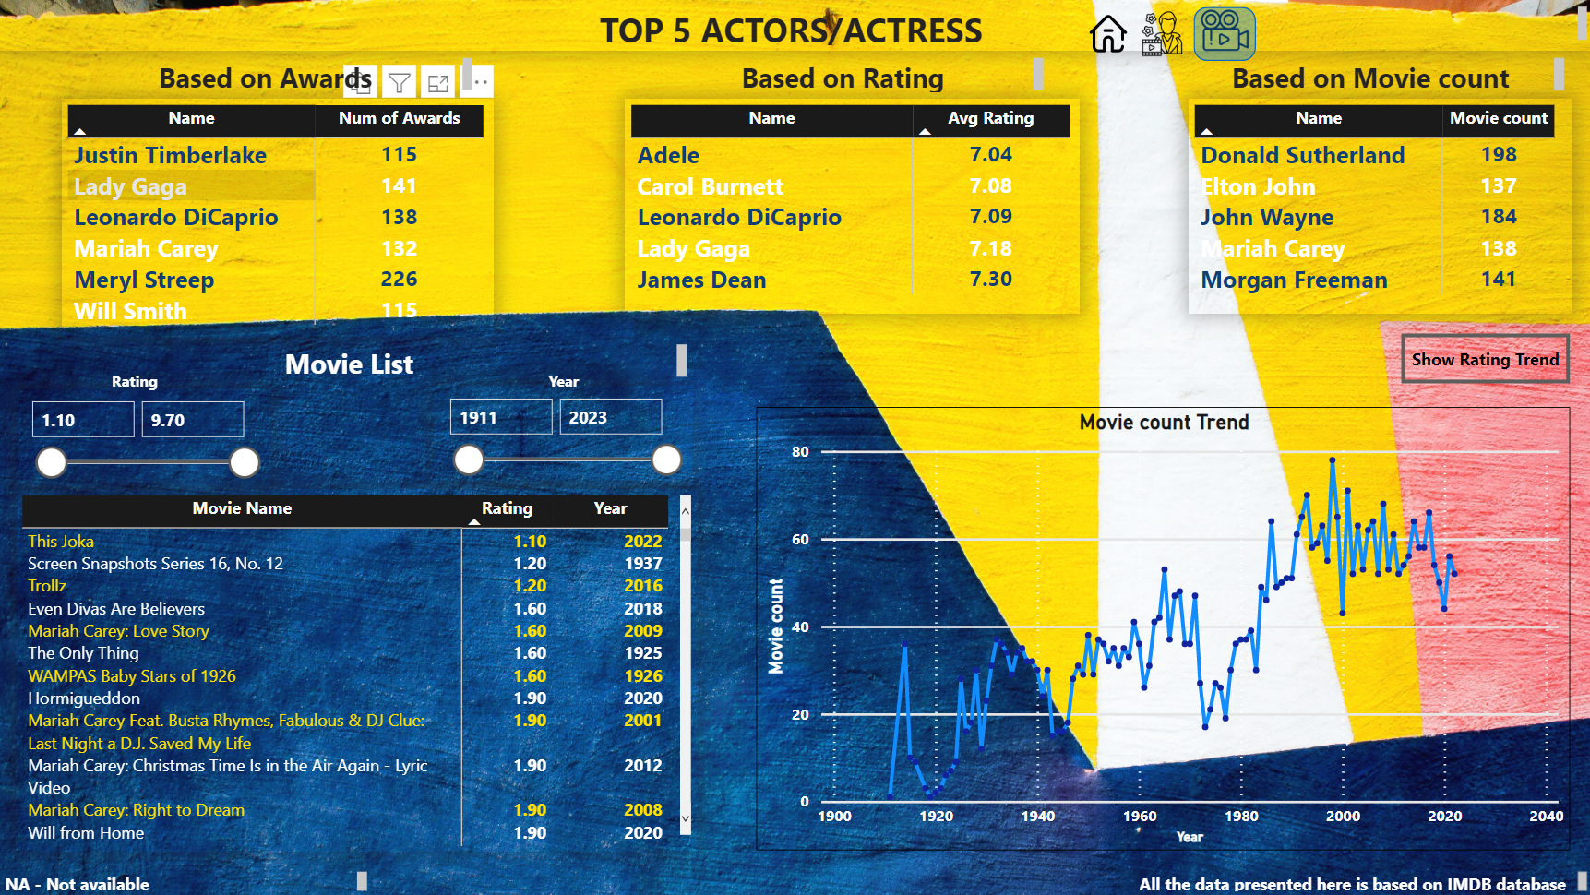
Movie Analysis Page

Slide 13
KPIs (Key Performance Indicators)
Average Movie rating of the Entertainer
Total number of movies acted by the Entertainer
Total number of awards
Breakthrough Movie year
Break through Movie name
First major award year
Date of birth of the Entertainer
Height of the Entertainer
One of the famous Quote of the Entertainer
Trademarks of the Entertainer
Nicknames of the Entertainer

Slide 14
Some of the insights from the Report
Meryl Streep is the entertainer who received highest number of awards among other entertainers
Top 6 entertainers who received most of the awards
Meryl Streep
Lady Gaga
Leonardo DiCaprio
Mariah Carey
Justin Timberlake
Will Smith
James Dean has the highest average rating of movies among others
Highest number of movies (55) released till date was on 1998
Highest average rating of movies was on 1949
Donald Sutherland acted in highest number of movies till date, which was 198 movies

Slide 15
As it is a entertainer’s analysis project, based on the end user need they can consume a lot of insights from the dashboard.
For the filtering purpose based on the end user need, in entertainers analysis page, there is a drop down filter to select the particular entertainer.
In Movie analysis page, Included several filters like rating and year, so the end user can filter the data according to their interest

Slide 16


